Slide 1
Release notes
03.01.2016 | Slide 6 – Fortinet Product Icons added: FortiGate VMX Service Manager Slide 18 – Fortinet Network Elements Icons added: Data Leakage Prevention Slide 24 – Fortinet Network Elements Icons added: Round Router
Icon Library
03.01.2016

Slide 2














PLATFORM – Core Elements
DARK
LIGHT
OPAQUE
STYLIZED
DARK
LIGHT
OPAQUE
STYLIZED
DARK
LIGHT
OPAQUE
STYLIZED
FortiGuard
FortiASIC
CP8
FortiASIC
Editable
Edit
Edit
Edit
FortiCare
FortiASIC
CP9
Generic CPU
Editable
CPU
CPU
CPU
FortiOS
FortiASIC
DP2
FortiOS
5.2
FortiASIC
FortiASIC
NP6
FortiOS
5.0
FortiASIC
SoC2
FortiOS
5.4
5.4
FortiASIC
SoC3
FortiOS
Editable
X.X
X.X
X.X
FortiASIC
TP2
FortiASIC XP1

Slide 3


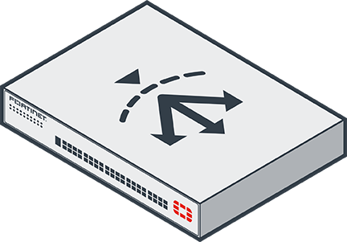
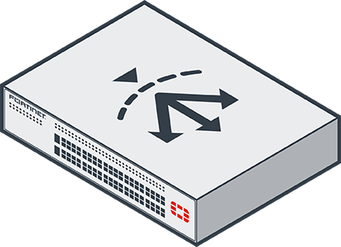



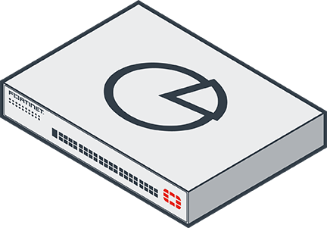
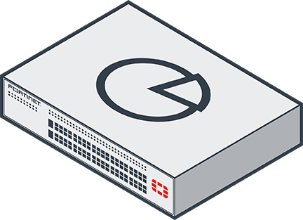






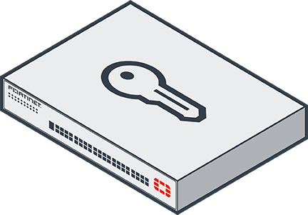
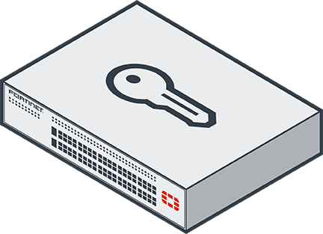

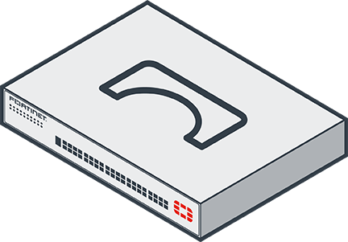
PRODUCTS – 1
DARK
LIGHT
VM
DARK
VM
LIGHT
CLOUD
DARK
CLOUD
LIGHT
RUGGED
DARK
RUGGED
LIGHT
STYLIZED
ISO
DESKTOP
ISO
1U
ISO
2U
ISO
3U
ISO
ALT-1
ISO
ALT-2
ISO
ALT-3
FortiADC
FortiAnalyzer
FortiAP
See Slide 9
FortiAP-C
FortiAP-S
FortiAP-N
FortiAuthenticator
FortiBridge

Slide 4

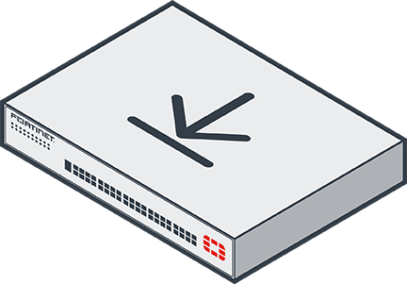
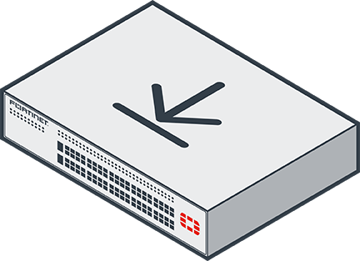









PRODUCTS – 2
DARK
LIGHT
VM
DARK
VM
LIGHT
CLOUD
DARK
CLOUD
LIGHT
RUGGED
DARK
RUGGED
LIGHT
STYLIZED
ISO
DESKTOP
ISO
1U
ISO
2U
ISO
3U
ISO
ALT-1
ISO
ALT-2
ISO
ALT-3
FortiCache
FortiCamera
FortiCall
FortiClient - Desktop
See
Slide 19
FortiClient - Laptop
See
Slide 19
FortiClient - Mobile
See
Slide 19
FortiClient - EMS
FortiCloud

Slide 5



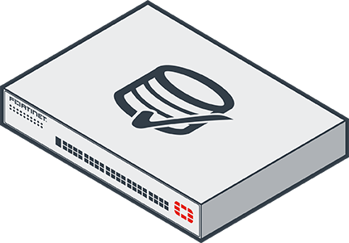
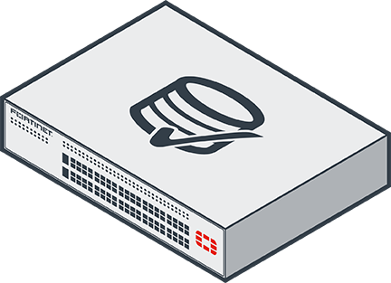

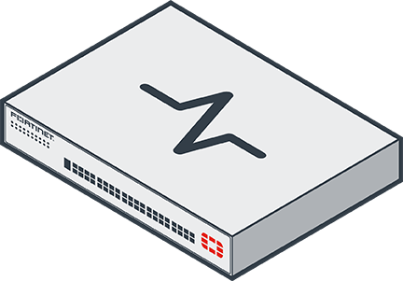
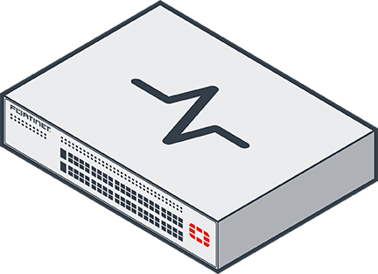





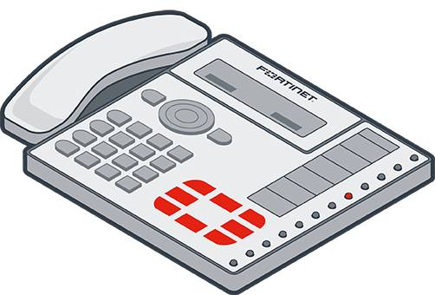
PRODUCTS – 3
DARK
LIGHT
VM
DARK
VM
LIGHT
CLOUD
DARK
CLOUD
LIGHT
RUGGED
DARK
RUGGED
LIGHT
STYLIZED
ISO
DESKTOP
ISO
1U
ISO
2U
ISO
3U
ISO
ALT-1
ISO
ALT-2
ISO
ALT-3
FortiConverter
FortiCore
FortiDB
FortiDDoS
FortiDeploy
FortiDirector
FortiExtender
FortiFone

Slide 6

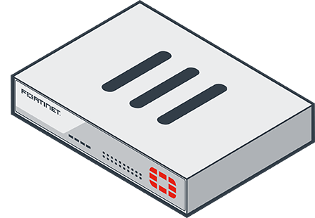
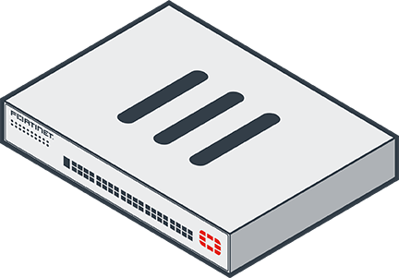
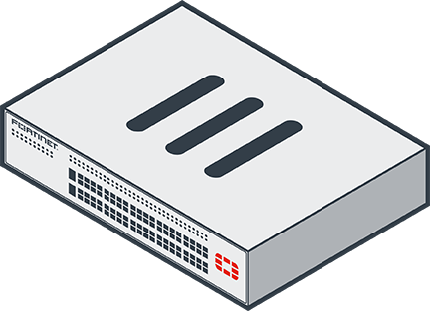
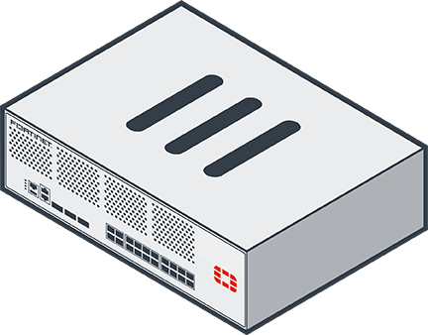
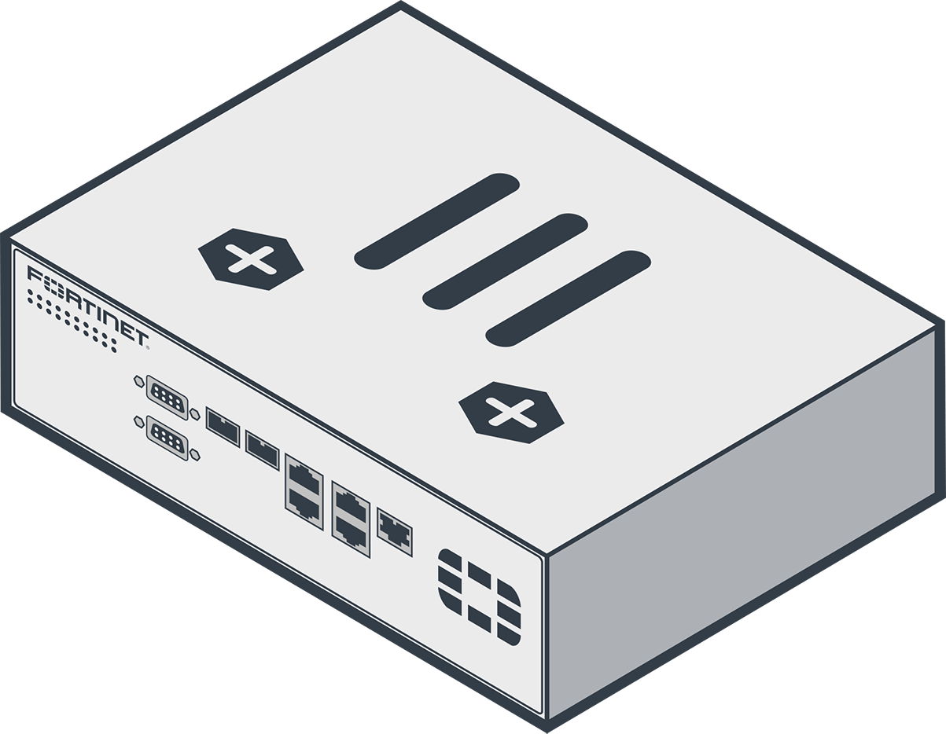

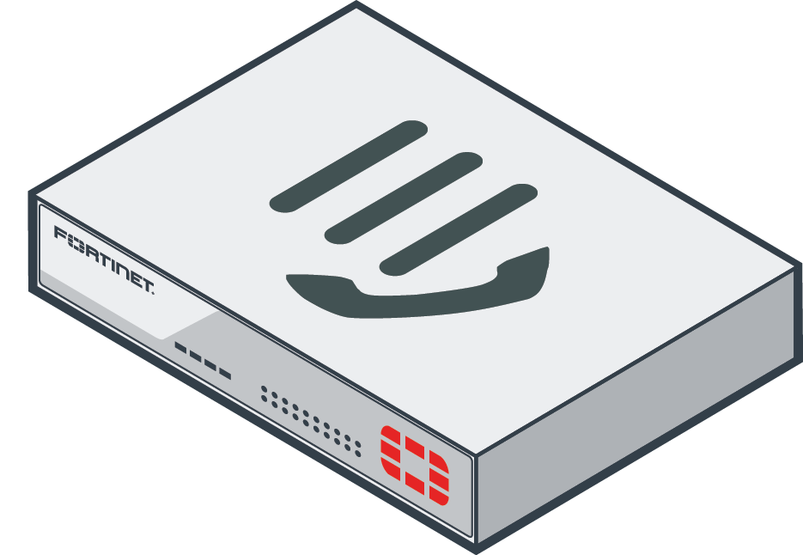
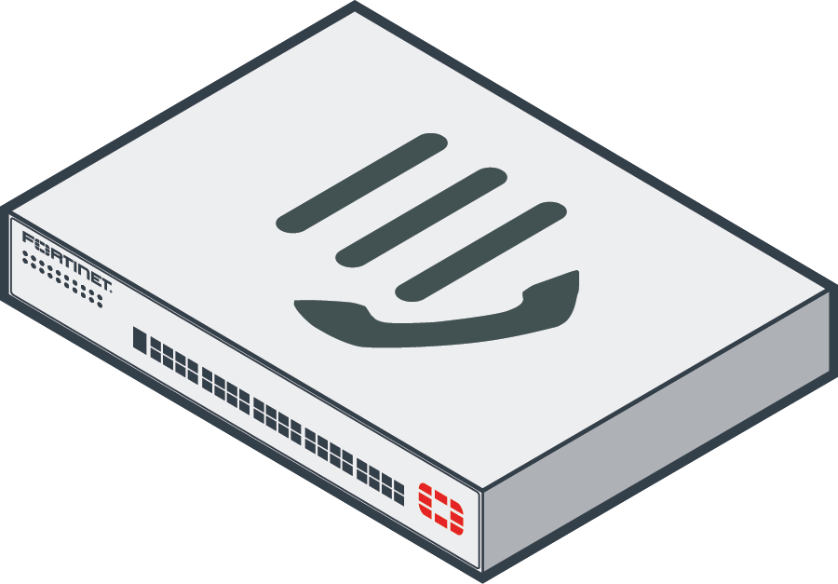

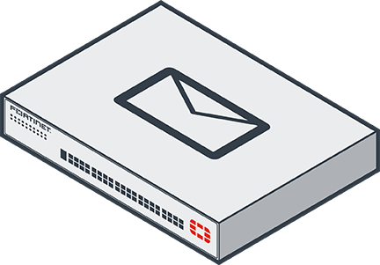
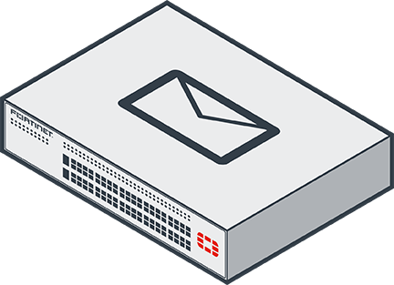



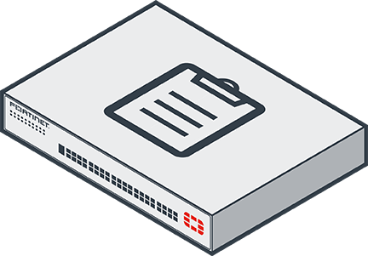
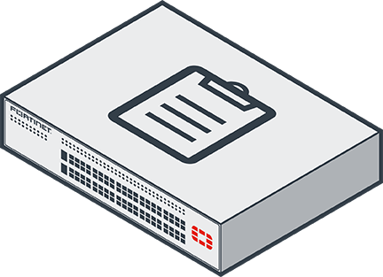

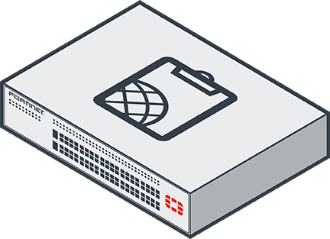
PRODUCTS – 4
DARK
LIGHT
VM
DARK
VM
LIGHT
CLOUD
DARK
CLOUD
LIGHT
RUGGED
DARK
RUGGED
LIGHT
STYLIZED
ISO
DESKTOP
ISO
1U
ISO
2U
ISO
3U
ISO
ALT-1
ISO
ALT-2
ISO
ALT-3
FortiGate
FortiGate
Chassis Blade
FortiGate Voice
FortiGate VMX
Service Manager
FortiLink
FortiMail
FortiManager
FortiMoM

Slide 7

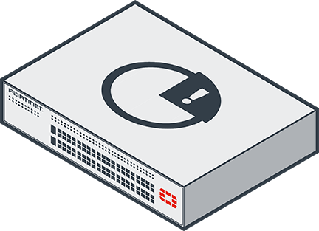


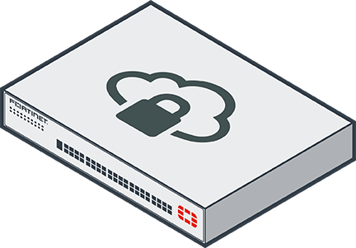

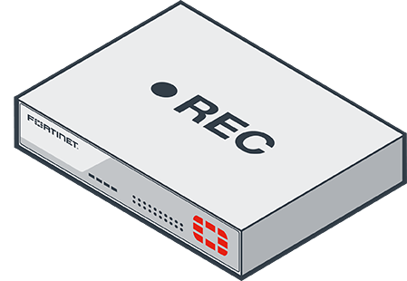
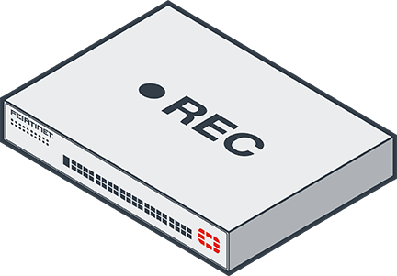

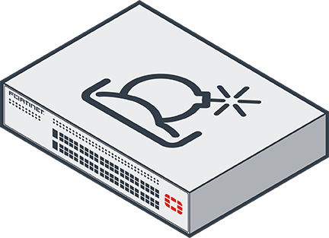

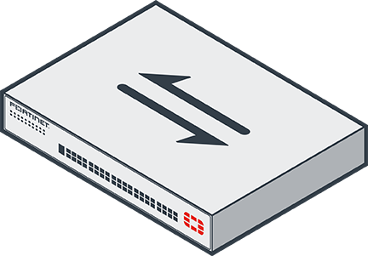
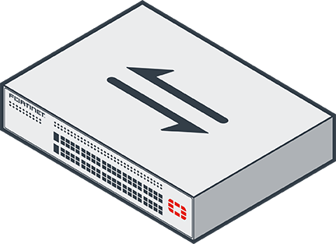
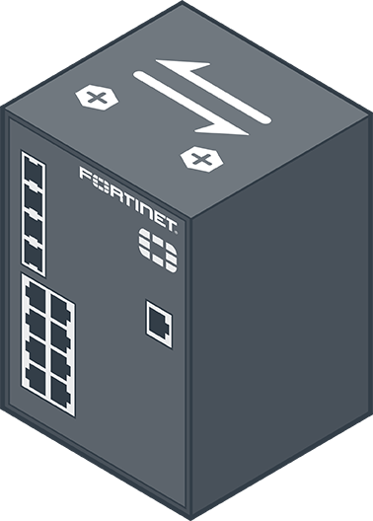


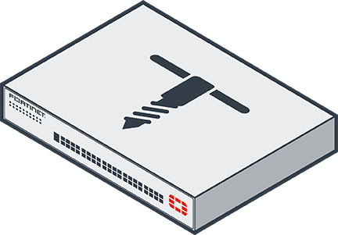
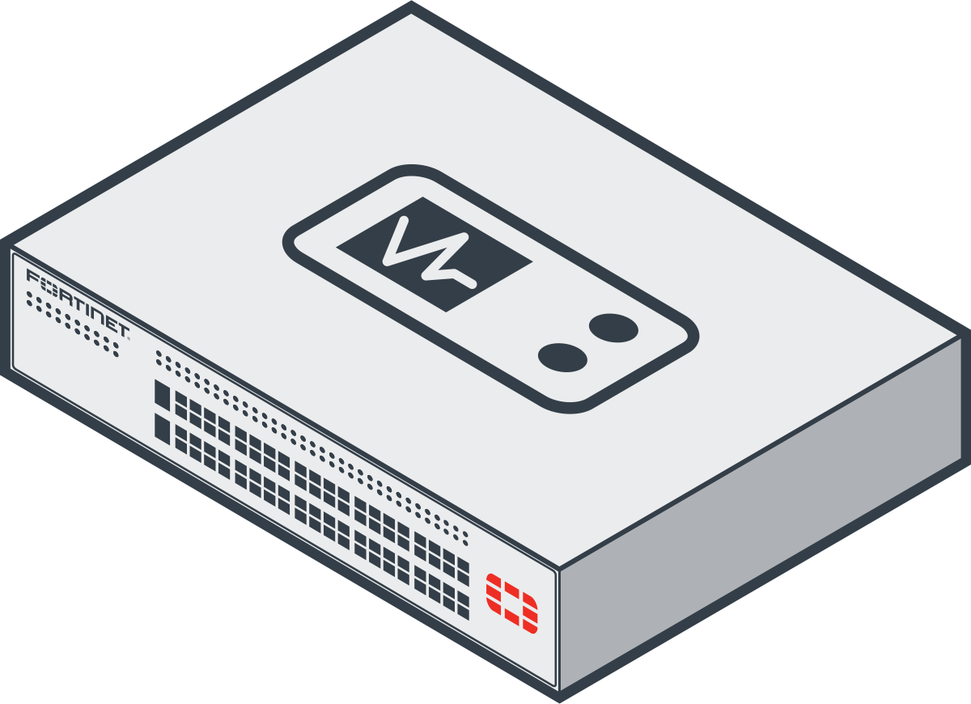
PRODUCTS – 5
DARK
LIGHT
VM
DARK
VM
LIGHT
CLOUD
DARK
CLOUD
LIGHT
RUGGED
DARK
RUGGED
LIGHT
STYLIZED
ISO
DESKTOP
ISO
1U
ISO
2U
ISO
3U
ISO
ALT-1
ISO
ALT-2
ISO
ALT-3
FortiMonitor
FortiPresence
See Slide 10
FortiPrivateCloud
FortiRecorder
FortiRPS
FortiSandbox
FortiSwitch
FortiTap

Slide 8
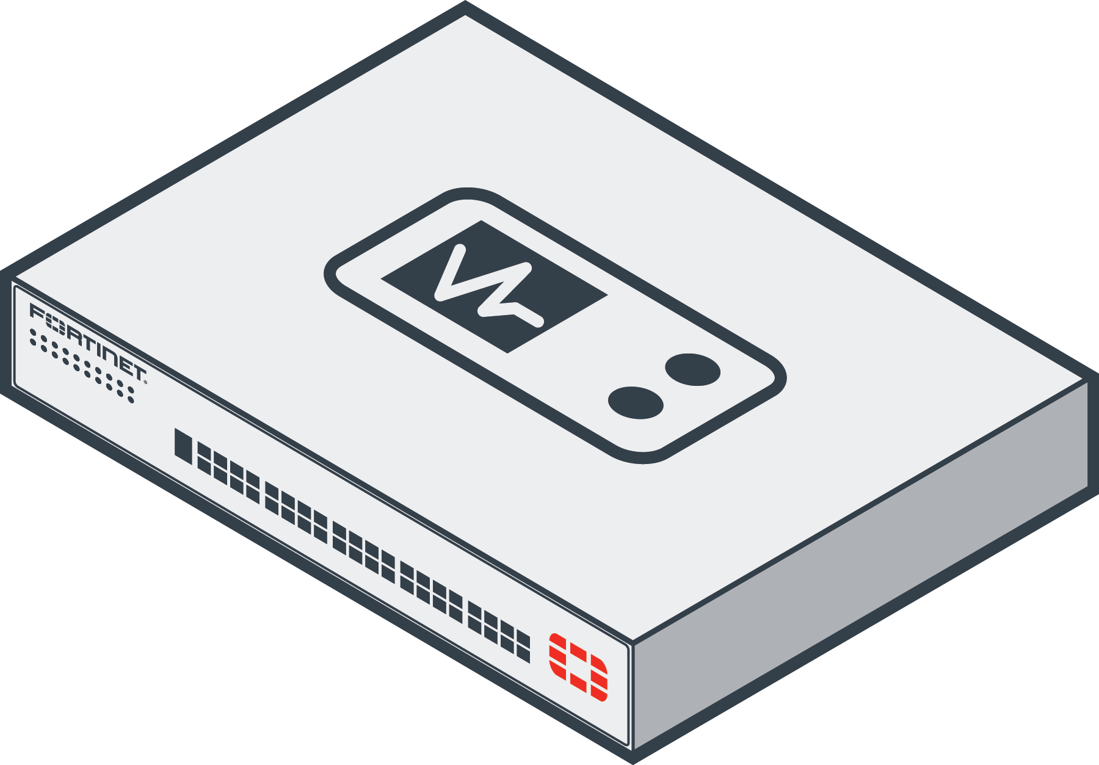
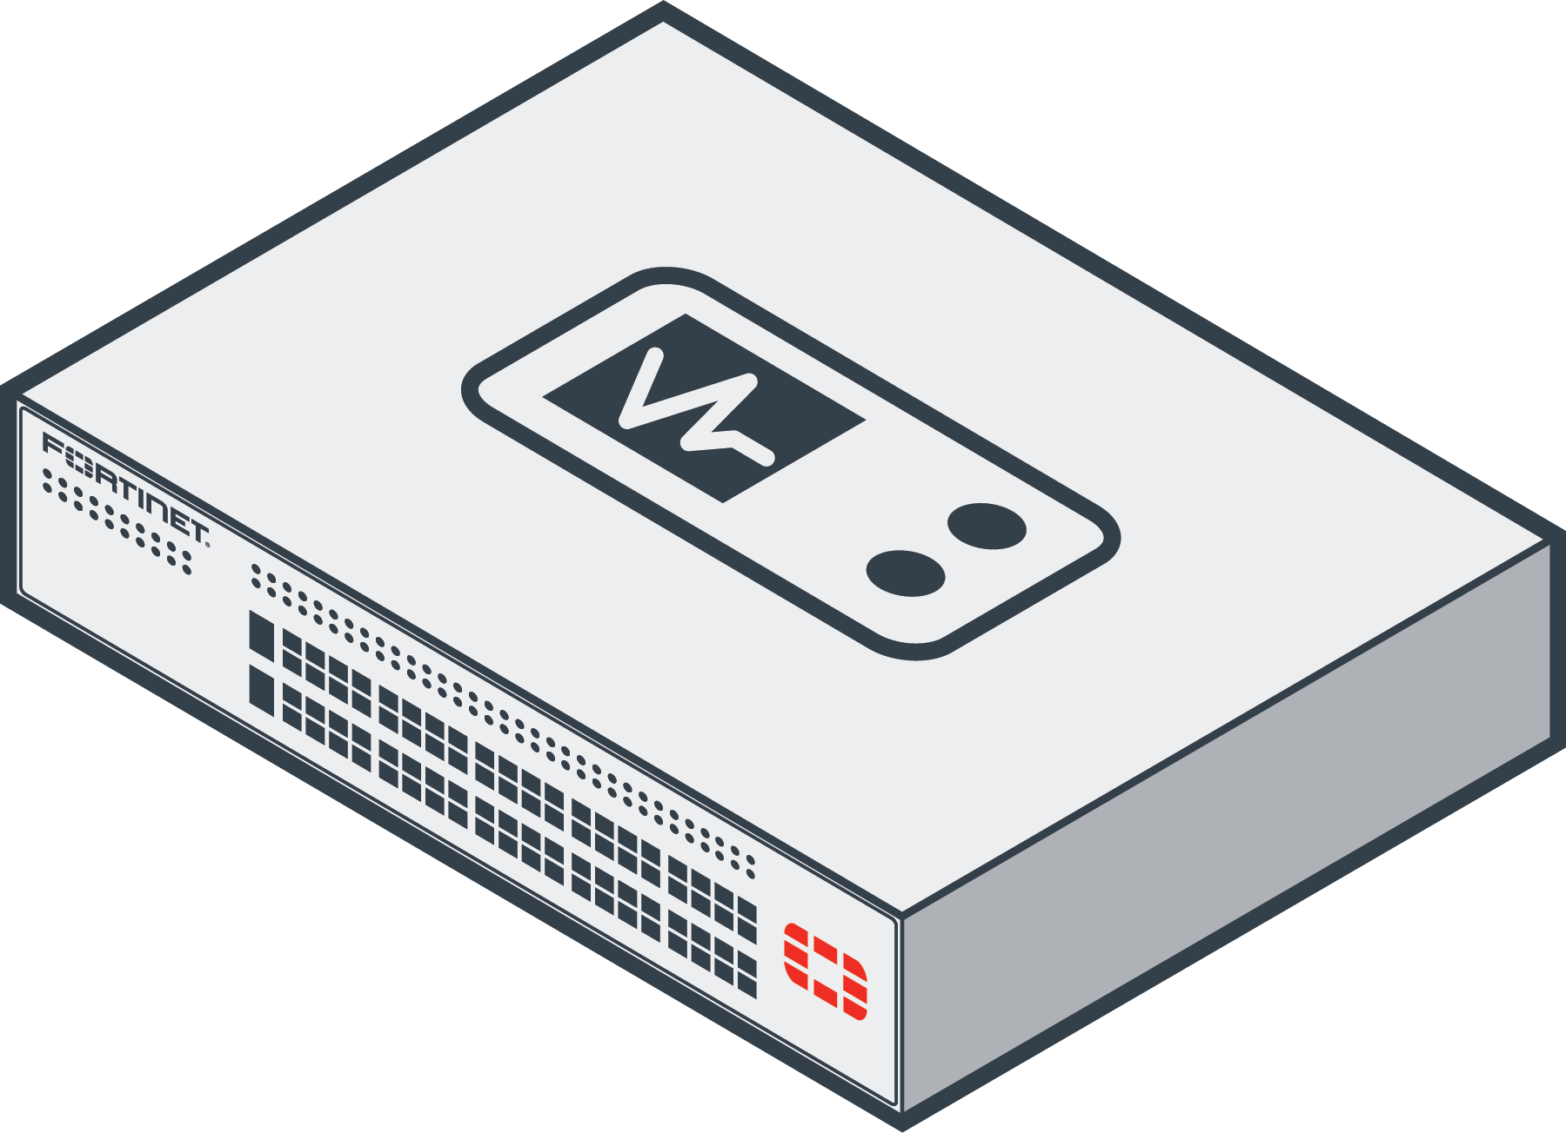
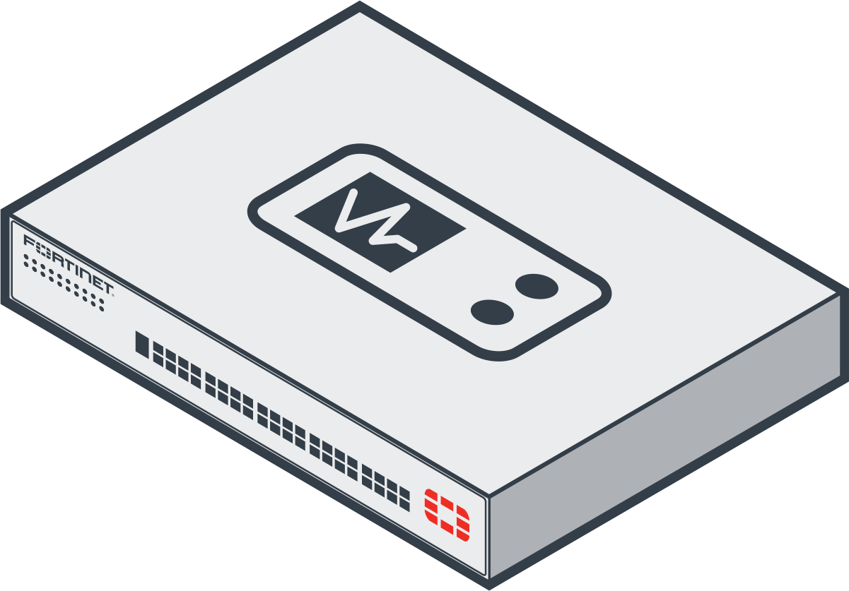
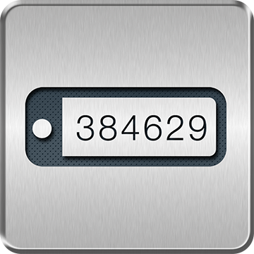
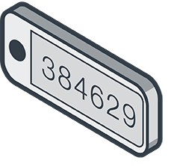


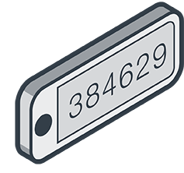

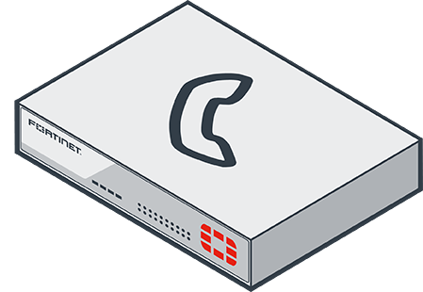
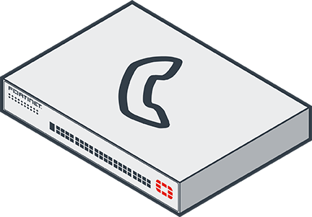

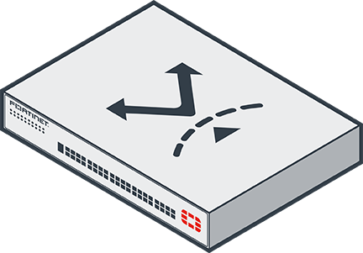
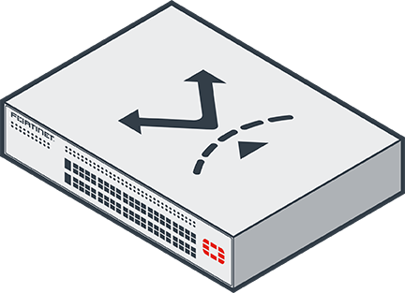

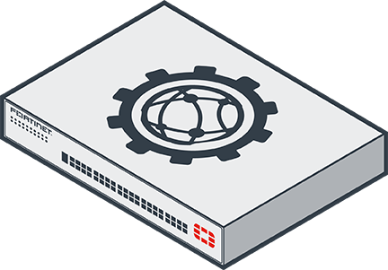
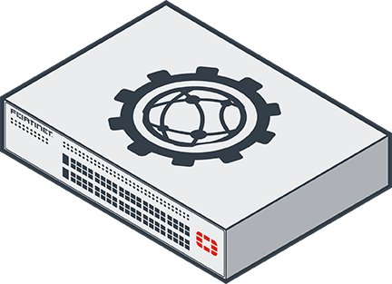

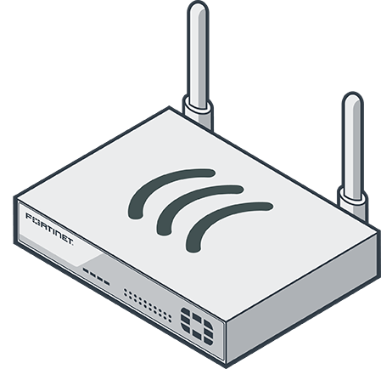

PRODUCTS – 6
DARK
LIGHT
VM
DARK
VM
LIGHT
CLOUD
DARK
CLOUD
LIGHT
RUGGED
DARK
RUGGED
LIGHT
STYLIZED
ISO
DESKTOP
ISO
1U
ISO
2U
ISO
3U
ISO
ALT-1
ISO
ALT-2
ISO
ALT-3
FortiTester
FortiToken
FortiView
FortiVoice
FortiWAN
FortiWeb
FortiWiFi
FortiWLC

Slide 9


PRODUCTS – 7
DARK
LIGHT
VM
DARK
VM
LIGHT
CLOUD
DARK
CLOUD
LIGHT
RUGGED
DARK
RUGGED
LIGHT
STYLIZED
ISO
DESKTOP
ISO
1U
ISO
2U
ISO
3U
ISO
ALT-1
ISO
ALT-2
ISO
ALT-3
FortiWLM
FNDN

Slide 10
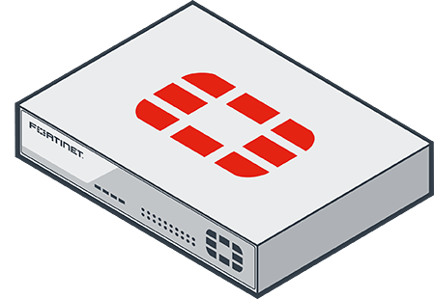

















PRODUCTS – 7
ISO
DESKTOP
ISO
1U
ISO
2U
ISO
3U
ISO
ALT-1
ISO
ALT-2
ISO
ALT-3
Legacy Meru Products
Generic Fortinet
RUGGED
Mobility
Center
Entry Level
(Desktop)
Midrange
(1u)
High-End
(2u, 3u and Chassis)
FortiGate Family
Bonjour
Collaborator
Network
Manager
Spectrum
Connect
Virtual Products
Rugged
Outdoor FAP
Outdoor
FAP
Remote
FAP
Indoor
FAP
Indoor FAP
(Antennas)
Hypervisor
FortiAP
NOTE: Images were enlarged to show detail. These are not at
same scale as server icons.

Slide 11















































FEATURES
Form Factor
FortiASIC
Interface
Power
Storage
Wi-Fi

Slide 12











THREATS & THREAT SERVICES – 1
FortiGuard Service
Generic Protection Technology
FortiGuard Service
PROTECTION TECHNOLOGY
Generic Protection Technology
DARK
LIGHT
OPAQUE
LIGHT
DARK
DARK
LIGHT
OPAQUE
LIGHT
DARK
Anti-botnet
IP Reputation
Intrusion Prevention
Application Control
Antivirus
Web Application Security
Vulnerability
Management
Advanced Threat Protection
Anti-spam
Database Protection
Web Filtering
Flood/DDoS Attack

Slide 13

THREATS & THREAT SERVICES – 2
FortiGuard Service
Generic Protection Technology
FortiGuard Service
PROTECTION TECHNOLOGY
Generic Protection Technology
DARK
LIGHT
OPAQUE
LIGHT
DARK
DARK
LIGHT
OPAQUE
LIGHT
DARK
Mobile Security Service

Slide 14












THREATS & THREAT SERVICES – 3
Threat
Base Image
Threat
Threat
GREY
RED
DARK
LIGHT
GREY
RED
GREY
RED
Botnet
Malicious URL
Flood/DDoS Attack
Hacker, Cybercriminal, Botmaster,
ID Thief…
Malicious App
Malware
Malicious Code
Vulnerability
Exploit
Generic
Known Threat
Spam/Phishing Message
Generic
Unknown Threat
Zombie
Bottleneck

Slide 15


Fortinet Solutions & Deployment Scenarios
REGULAR
SYMBOL
REGULAR
SYMBOL
REGULAR
SYMBOL
Carrier Class Firewall
Next-Generation
Firewall
ATP Framework
Cloud Security
Cloud Firewall
Unified Threat Management
Connected UTM
Data Center
Firewall
Virtual Firewall
Data Center Security
Firewall
Enterprise Firewall
Internal Segmentation
Firewall
Secure Access
Architecture

Slide 16



NETWORK ELEMENTS – Generic Technology - 1
LIGHT
DARK
GREY
LIGHT
DARK
GREY
Firewall
Traffic Shaping
VPN
Bottleneck
SSL VPN
VDOM
IPsec VPN
VLAN
2FA
SDN
WAN
Wireless

Slide 17
NETWORK ELEMENTS – Generic Technology - 2
LIGHT
DARK
GREY
LIGHT
DARK
GREY
Safe
Server Load Balancing
Surveillance
Camera
WOC
LDAP Server
Switching
AD Server
Segmentation
Identity and
Access
Compliance
High
Availability
Open Ports

Slide 18

NETWORK ELEMENTS – Generic Technology - 3
LIGHT
DARK
GREY
LIGHT
DARK
GREY
OS Fingerprinting
Data Leakage Prevention
PIN Pad
Security
Profiles
Troubleshooting
Central
Management
Secure Email

Slide 19













NETWORK ELEMENTS – Buildings 1
FLAT
ISOMETRIC
FLAT
ISOMETRIC
Headquarters
Retail Large
Enterprise
Retail Small
Mid-Enterprise
Small Business
Branch Office
Residential

Slide 20

















NETWORK ELEMENTS – Buildings 2
FLAT
ISOMETRIC
FLAT
ISOMETRIC
Government
Church
University
Hospital
School
Power Plant
Bank
Manufacturing

Slide 21


NETWORK ELEMENTS – Buildings 3
FLAT
ISOMETRIC
FLAT
ISOMETRIC
Data Center Building
Service Provider
Cell Tower
Data Center

Slide 22
















NETWORK ELEMENTS – Fortinet Devices
NETWORK ELEMENTS –
FLAT
ISOMETRIC
FLAT
ISOMETRIC
Server Rack
FortiClient
Desktop
1u Server
FortiClient
Monitor/Keyboard
FortiClient
Smartphone
FortiClient
Monitor
FortiClient
Laptop

Slide 23


















NETWORK ELEMENTS – Generic Devices - 1
NETWORK ELEMENTS –
FLAT
ISOMETRIC
FLAT
ISOMETRIC
Server Rack
Desktop
1u Server
Monitor/Desktop
Scott to create
Smartphone
Monitor/Keyboard
Laptop
Monitor

Slide 24











NETWORK ELEMENTS – Generic Devices - 2
FLAT
ISOMETRIC
FLAT
ISOMETRIC
Switch
LAN
Router
Round Router
Database
IC
Desktop Server
Memory

Slide 25

NETWORK ELEMENTS – Generic Devices - 3
FLAT
ISOMETRIC
FLAT
ISOMETRIC
Printer
PIN Pad
Phone
Wireless PIN Pad
Kiosk
Hard Drive
Point of Sale

Slide 26







NETWORK ELEMENTS – VM Components - 1

Slide 27
NETWORK ELEMENTS – VM Components - 2

Slide 28






















NETWORK ELEMENTS – Cloud
FLAT
ISOMETRIC
Generic Cloud
FortiPresence
FortiPrivateCloud
Cloud Editable
Editable
Editable
Editable
Editable
Editable
Editable

Slide 29
















NETWORK ELEMENTS – People 1
Admin Man
Child Boy
Admin Woman
Child Girl
Exec Man
Thief
Exec Woman
Reseller

Slide 30
NETWORK ELEMENTS – People 2
IT Admin Desk
IT Admin Laptop
IT Server Room

Slide 31
NETWORK ELEMENTS – Vertical Related - 1
Aerospace
Finance
Education
K-12
Oil 1
Agriculture
Government
Hospitality
Bed
Oil 2
Energy
Healthcare
Hospitality
Bell
Retail
Finance
ATM
Education
Higher Ed
Manufacturing
Retail
Food

Slide 32
NETWORK ELEMENTS – Vertical Related - 2
Service Provider - 1
Transportation
Truck - 1
Service Provider - 2
Transportation
Truck - 2
Transportation
Plane
Utilities
Transportation
Train

Slide 33






MISCELLANEOUS
OS LOGOS
REGIONAL LOGOS
LIGHT
DARK
AMERICA
LATAM
Android
Linux
Windows 7
Windows 8
APAC
Apple
Apple iOS
EMEA

Slide 34
Suggestions?
If we are missing any icons, or if you have suggestions for new ones – please contact: icons@fortinet.com

